Slide 1
Converting between Fractions, Decimals and Percentages Lesson 4: Converting Percentages and Decimals to Fractions

Slide 2
Learning Objective
To develop an understanding of how to convert percentages and decimals to fractions.
Targeting Assessment Objective: A01
Success Criteria
To convert a percentage to a fraction.
To be able to write a fraction in its simplest terms.
To convert a decimal to a fraction.

Slide 3

Quick Maths
Find the highest common factor of each pair of numbers:
Calculate the answers to the following questions:
24 and 28
16 and 40
12 and 20
10 and 55
18 and 72
4
8
4
5
18
456 ÷ 10
788 ÷ 100
12.3 ÷ 10
72.08 ÷ 100
0.52 ÷ 100
= 45.6
= 7.88
= 1.23
= 0.7208
= 0.0052
Extension
If 292 is the answer, what could the question be?

Slide 4
Converting Percentages to Fractions
To convert a percentage to a fraction in its simplest form, we firstly need to write it as a fraction of 100. We use 100 as our denominator because ‘per cent’ translates to ‘per 100’.
Write 34% as a fraction in its simplest form
17 50
=
As our percentage is a whole number, we can write it as a fraction of 100:
34 100
However, our task is to write our answer in its simplest form. We can do this by finding the highest common factor of 34 and 100:
The highest common factor of 34 and 100 is 2.
34 100
÷ 2
17 50
÷ 2

Slide 5
Converting Percentages to Fractions
Things can be a little trickier if the percentage includes a decimal.
Write 12.5% as a fraction in its simplest form
1 8
=
12.5 100
Start by writing the fraction out of 100.
We don’t use decimals in proper fractions so we need to ‘get rid’ of the decimal.
We can multiply 12.5 by 10 so we no longer have the decimal point. However, we must do the same to the denominator.
12.5 100
× 10
125 1000
× 10
Like before, we must write our answer in its simplest form. We can do this by finding the highest common factor of 125 and 1000.
The highest common factor of 125 and 1000 is 125.
125 1000
÷ 125
1 8
÷ 125

Slide 6

Converting Percentages to Fractions
Convert each percentage to a fraction.
Write each answer in its simplest form.
45%
64%
5%
17.5%
2.5%
45 100
9
20
=
64 100
16
25
=
5 100
1
20
=
175 1000
7
40
=
25 1000
1
40
=

Slide 7
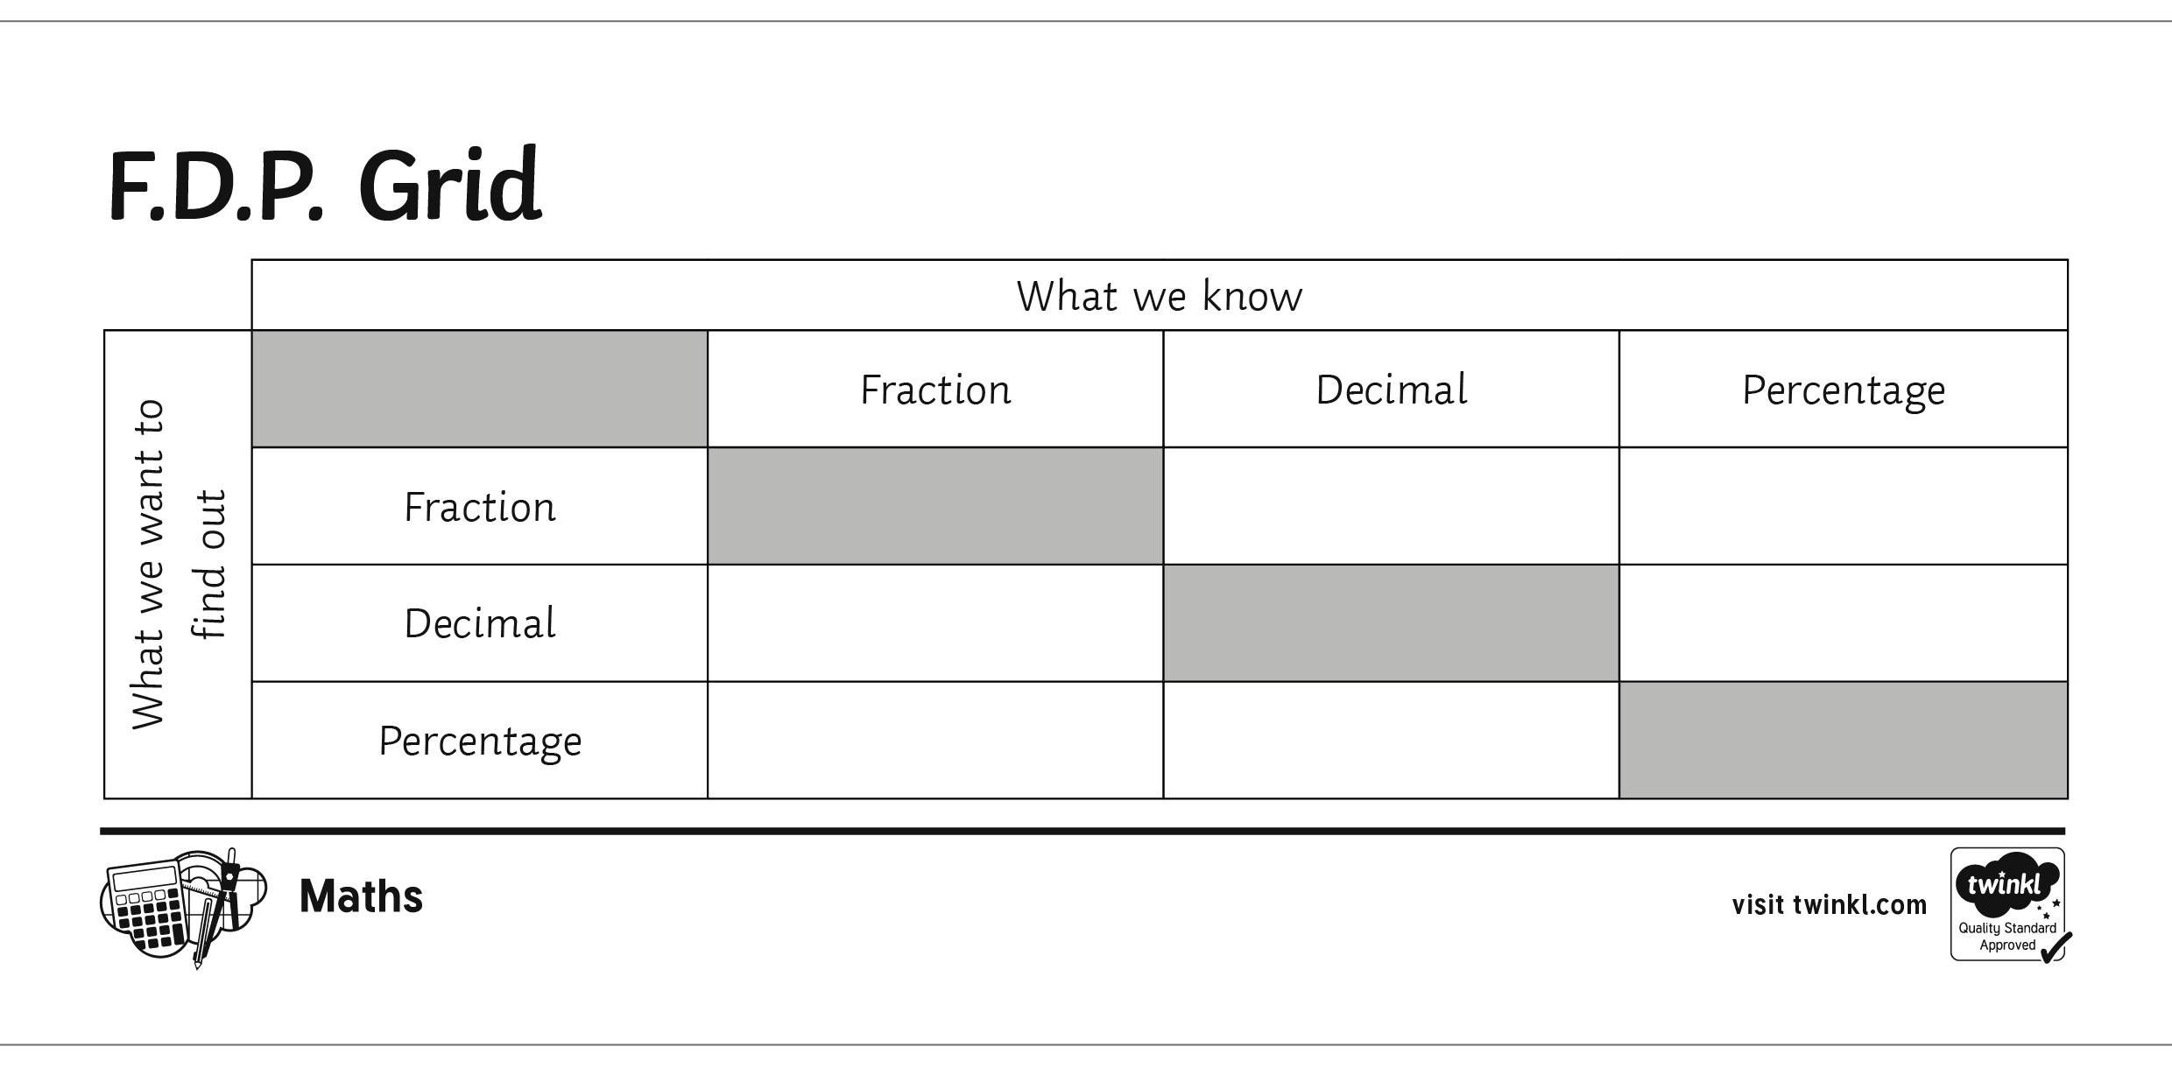
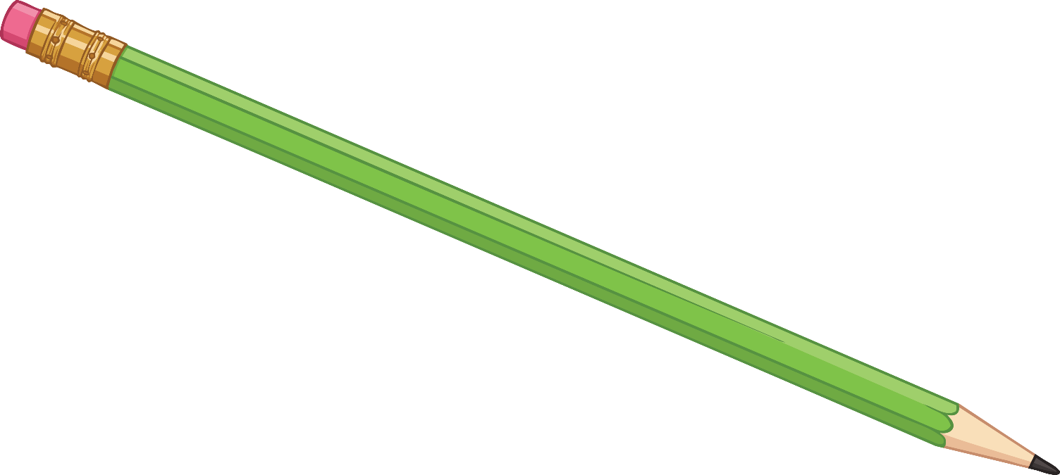
F.D.P. Grid
Place percentage over
100 (or 1000)
and simplify
Divide numerator by denominator
Divide by 100
Divide numerator by denominator then multiply by 100
Multiply by 100

Slide 8
Converting Decimals to Fractions
To convert a decimal to a fraction, we start by writing it out of 1.
Write 0.15 as a fraction in its simplest form
3 20
=
0.15 1
Start by writing down the decimal as a ‘fraction’ of 1:
As we have two decimal places, we multiply both the numerator and the denominator by 100 (if there was just 1 digit after the decimal point, we would multiply it by 10 and if there were 3 digits, we would multiply by 1000).
0.15 1
× 100
15 100
This is now a proper fraction.
× 100
Like before, we must write our answer in its simplest form. We can do this by finding the highest common factor of 15 and 100.
The highest common factor of 15 and 100 is 5.
15 100
÷ 5
3 20
÷ 5

Slide 9
Converting Decimals to Fractions
Let’s try another example:
Write 0.375 as a fraction in its simplest form
3 8
=
0.375 1
Start by writing down the decimal as a ‘fraction’ of 1:
Multiply both the numerator and the denominator by 1000 (because there are 3 digits after the decimal point).
0.375 1
× 1000
375 1000
This is now a proper fraction.
× 1000
Like before, we must write our answer in its simplest form. We can do this by finding the highest common factor of 375 and 1000.
The highest common factor of 375 and 1000 is 125.
375 1000
÷ 125
3 8
÷ 125

Slide 10
Converting Decimals to Fractions
Convert each percentage to a fraction.
Write each answer in its simplest form.
0.55
0.78
0.4
0.02
0.235
55 100
11
20
=
78 100
39
50
=
40 100
2
5
=
2 100
1
50
=
235 1000
47
200
=

Slide 11
F.D.P. Grid
Place fraction over 1, multiply by 10, 100 or 1000 and simplify
Place percentage over
100 (or 1000)
and simplify
Divide numerator by denominator
Divide by 100
Divide numerator by denominator then multiply by 100
Multiply by 100

Slide 12
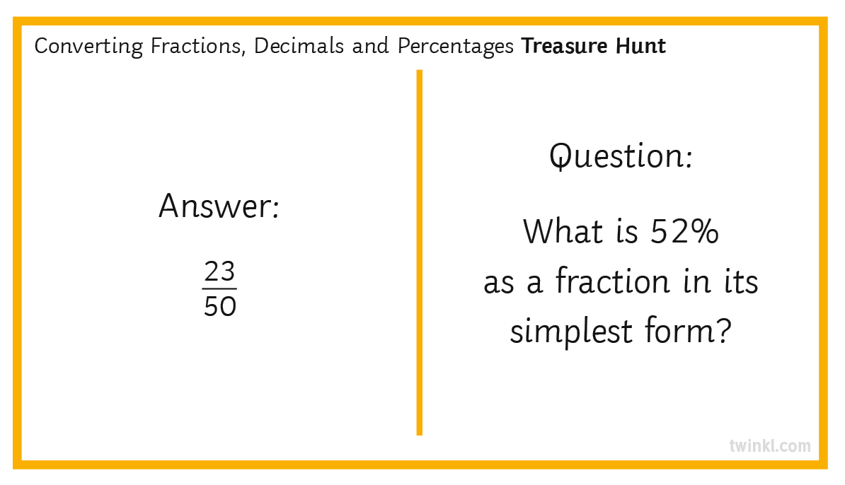
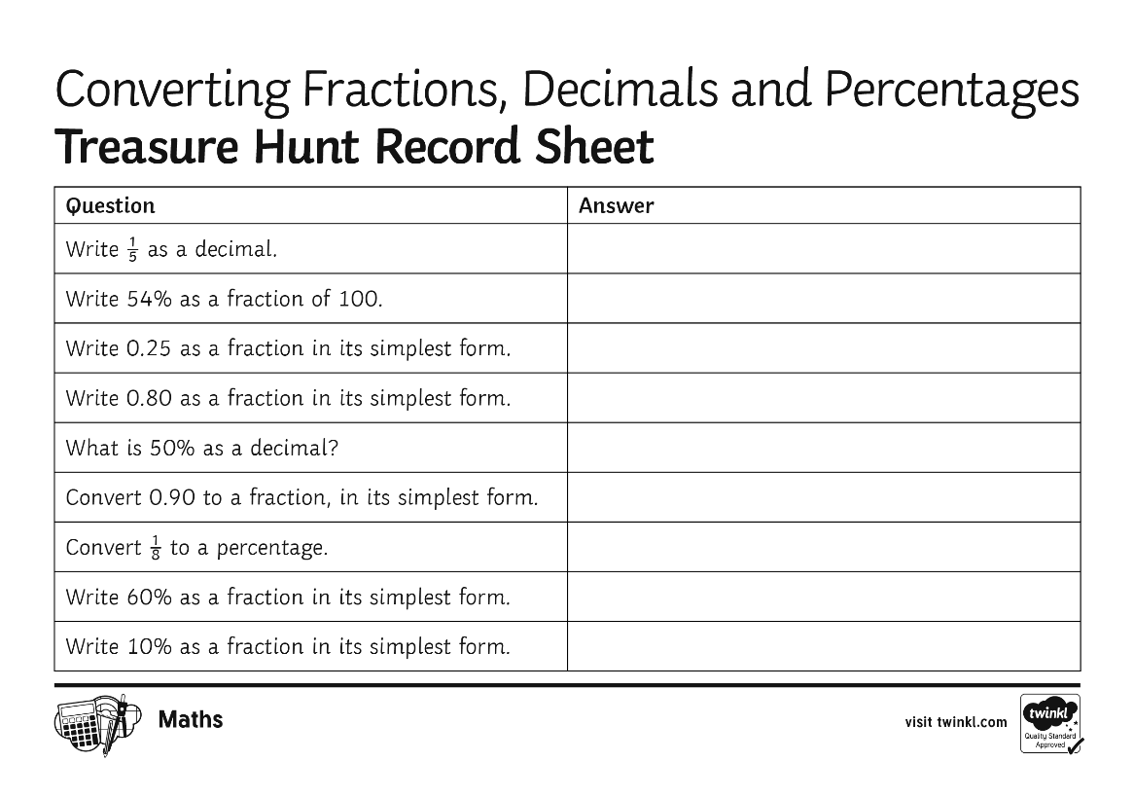
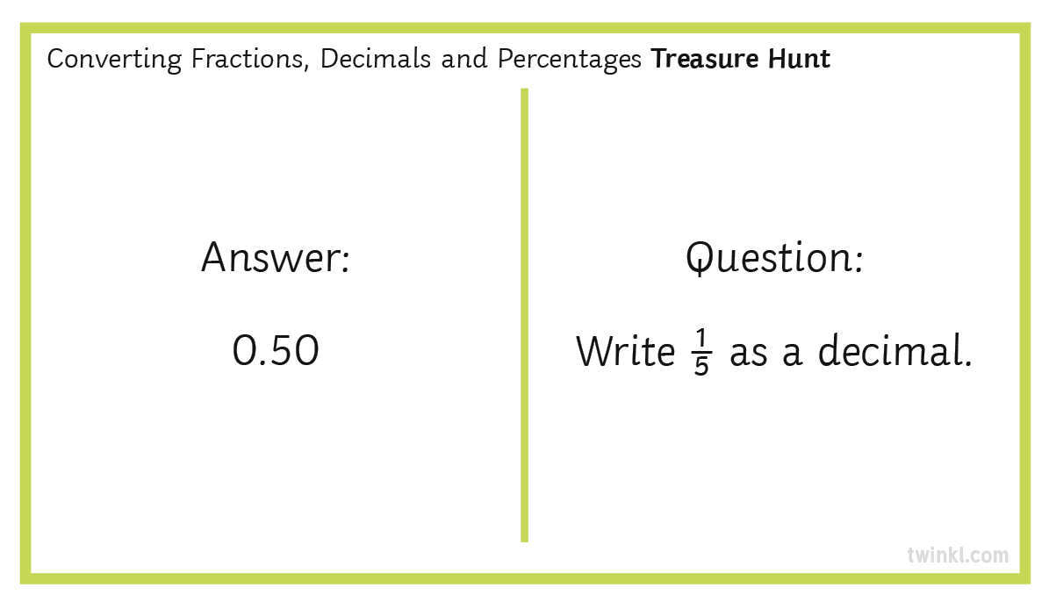
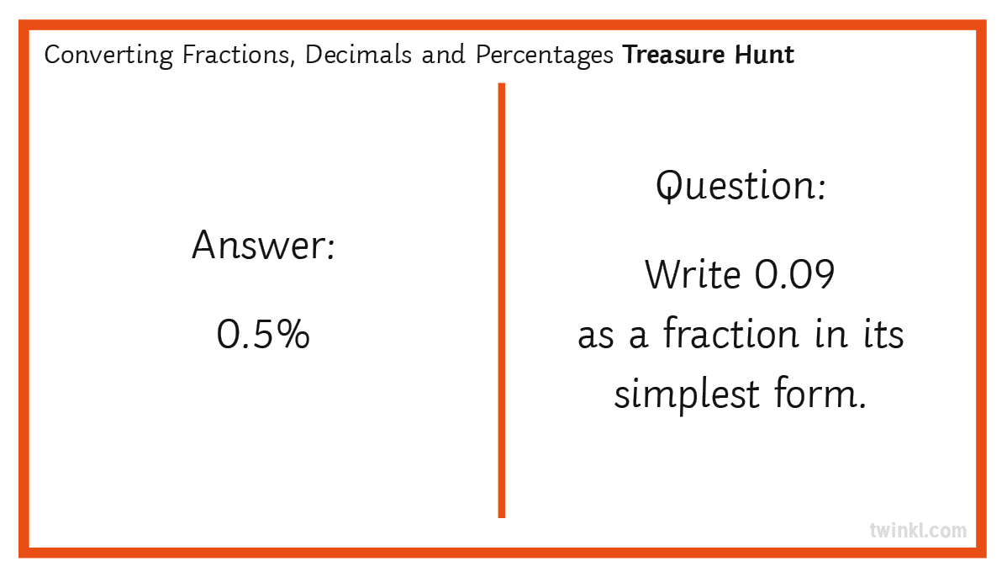
Your Turn

Slide 13

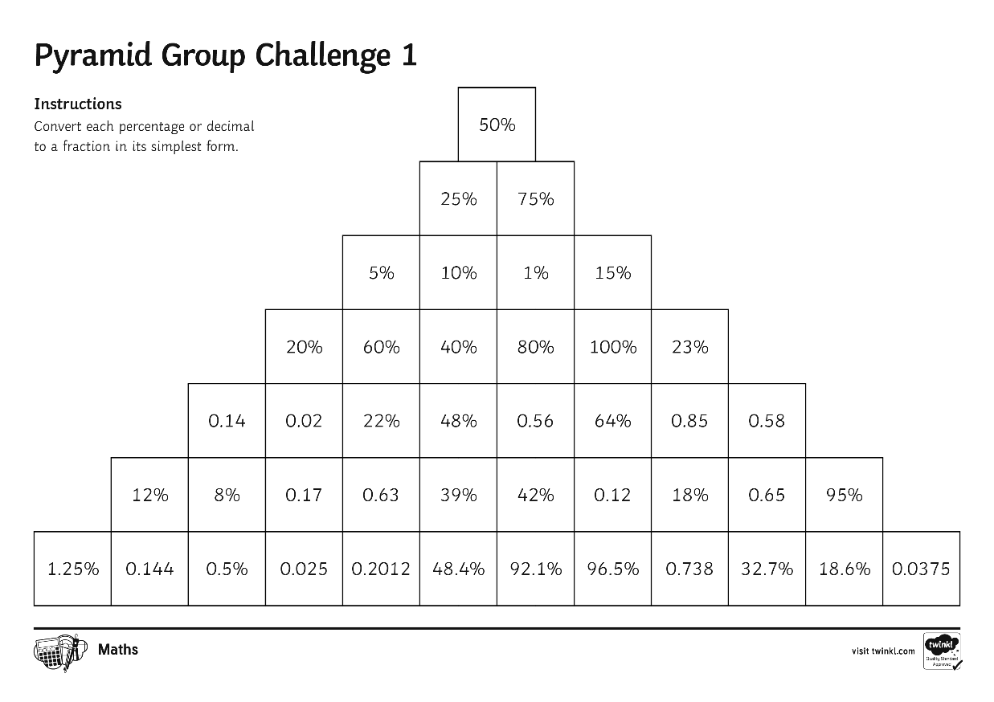
Pyramid Challenge
The pyramid challenge is designed to be completed in groups.
The timer will be set; it is your challenge to complete as much of the pyramid, as a group, as possible. Accuracy and speed is key.
Think about how you can divide the pyramid up into sections so you can complete it quicker.
Remember: every member of your group must be doing something.

Slide 14
5
5 minutes…
4
1
STOP!
GO!
3
2

Slide 15



Sticky Note Finish
On your sticky note, write down…
one thing you have learnt today.
one thing you would like to revisit.

